Slide 1

Columbia Asia Hospital Project
Right Here For You
Vinay Sharma
Date: 10.03.2024

Slide 2
The problem
Introduction
Context and Charts
Problem statement
Columbia Asia Hospital is a multi-specialist hospital having the multi-specialists doctors. Currently the hospital is seeking for the consultation on various key insights to improve their in various aspects.
We have use the multiple steps like data cleaning, charts and DAX functionalities in order to achieve the key insights. The charts will reflects the overall insights regarding hospital, doctors and patients.
The Hospital is looking for the key insights for the following objectives:
Assess the hospital's revenue generation
Insights about suitable departments for new hires
Strategies and suggestions for patient discounts

Slide 3
Challenges deep-dive
Problem 1
Problem 2
Problem 3
Assess the hospital's revenue generation
We have to calculate the total revenue generated by the hospital as well as department wise in order to gain the key insights regarding the revenue generation
Insights about suitable departments for new hires
We have to check for the suitable department to place the newly hire doctors in hospital through analysis and provide the suggestion based on it.
Strategies and suggestions for patient discounts
On the basis of the overall key insights analysis we have to provide the strategies and suggestions to provide the patient discounts based on analysis with reason.

Slide 4
Solution 1
Solution 1
The first step we have to perform in the solution is the data cleaning. We have change the data type for the different column to correct the data format.
After Data cleaning we have perform the DAX function in order to calculate the total revenue of the hospital.
Total Revenue of the hospital is calculated on the basis of the DAX function as mentioned is $509.31M
Problem talk creates problems, Solution talk creates solutions.
Total Revenue = SUM(Doctor_patient_data[Total Bill])

Slide 5
Solution 1
Solution 1
We have created dashboard for the hospital insights containing the details such as revenue generated by hospital, average rating, doctors available in hospital, total number of visits.
We have added the date filter so that we can check the revenue, doctors availability, patient visit per department each day by just selecting date.
You are either part of the solution or part of the problem.

Slide 6
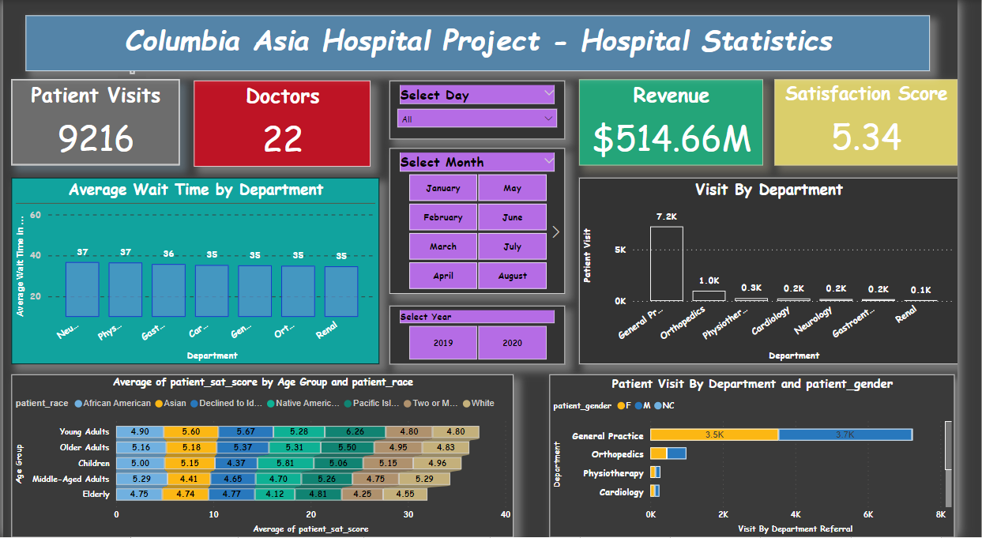
Dashboard 1

Slide 7
Solution 2
Insights about suitable departments for new hires
We have assess the department by various aspects like doctors availability in each department, patient visit in each department, appointment fee of doctor and revenue generated by doctor as we have created the filter of the doctor.As per the data analysis we have done over the data we would suggest the doctor in the department which has the highest work load which we can decide on the basis of average wait time.
Complaining is finding faults, wisdom is finding solutions

Slide 8
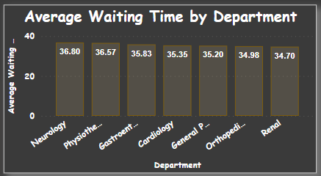
Solution 2
We have check the department wise average wait time and found the below insights and we can say that the Neurology Department has the highest average wait time.
To ask the right question is already half the solution of a problem.
Average Wait Time = AVERAGE('Hospital ER'[patient_waittime])

Slide 9
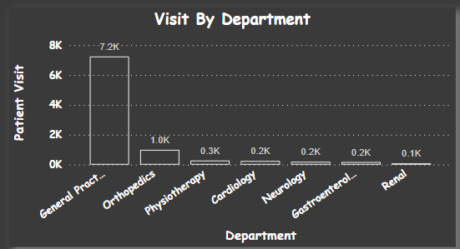
Solution 2
Also we can considered the patient visit for the placement of the new hire doctor. We can see the chart of the patient visit by department as below.
The solution to a problem changes the nature of the problem

Slide 10
Solution 2
We have created the dashboard for the showing the insights about the doctors, average satisfaction score , appointment fee, patient visit as per doctor as we have put the slicer of Doctor name. Also for the sake of insight about the revenue we have added the table of the revenue generated by each doctor. Have a look for the dashboard for the insights regarding doctor performance on the next slide.
When the solution is simple, God is answering.

Slide 11
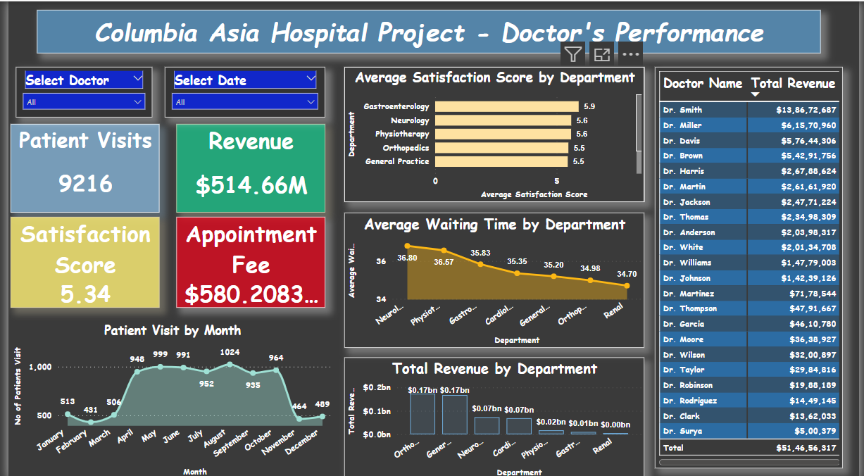
Dashboard 2

Slide 12
Solution 3
Strategies and suggestion for employee discount
Discounts to patients can be offered considering the multiple factors such as patient visit frequency, patient satisfaction score, Appointment fees of Doctor, department with lowest patient visit in order to promote more visits of patients to such departments.
"For every complex problem, there's a solution that is simple, neat, and wrong.”

Slide 13
Solution 3
In the given case we are considering a patient satisfaction score for offering a discount to patients as we are not aware of the cost for each patient in a particular department. Hence we can not consider the appointment or revenue of a particular department in order to consider it as a deciding factor.
When you always focus on the solutions, you shall always be a solution.

Slide 14
Solution 3
We will set the criteria for the eligibility of discount like discount will be availed to the patients who has satisfaction score more than 6. To calculate the discount eligibility we have use the below DAX function.
The art of being wise is the art of knowing that solutions don’t come from individuals, but rather experiences.
DAX Function:
Discount Eligibility = SWITCH(TRUE(), 'Hospital ER'[Patient_Sats_score] > 6,"Eligible","Not Eligible")

Slide 15
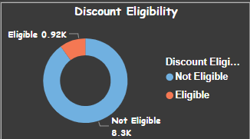
Solution 3
Chart representing the eligibility of discount for patient
Only in the present is your mind free to do what it does best — solve problems.
There are 917 patient who has patient satisfaction score of more than 6 which are eligible for discount.

Slide 16
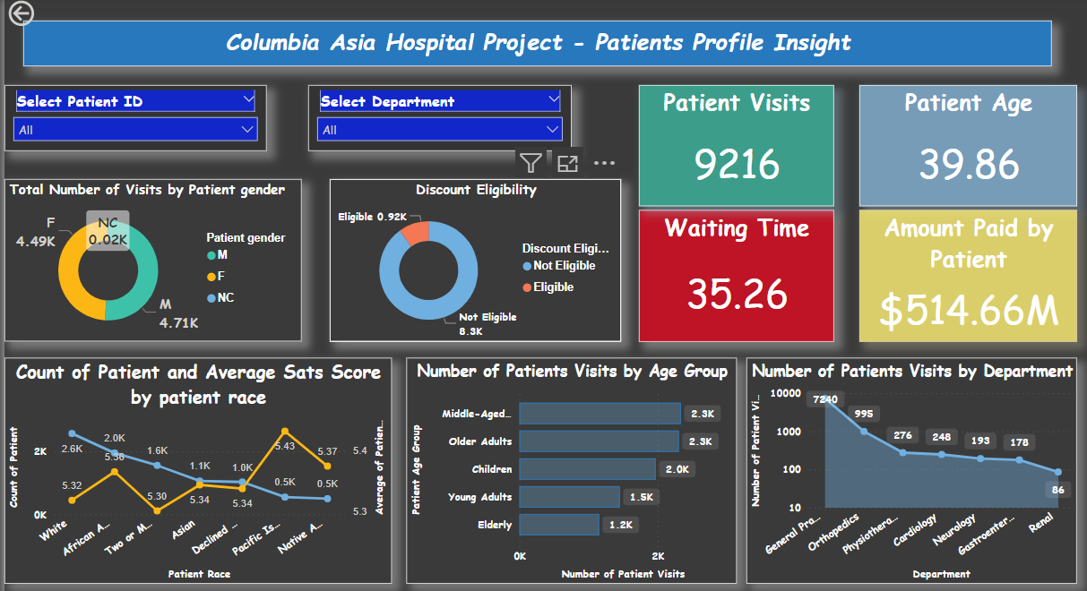
Dashboard 3

Slide 17
Summary for Analysis
Hospital Total Revenue
Average Satisfaction Score in Hospital
Total Patient Visits
$509.31M
Neurology and General Practice
9216
917
5.34
Department where the new hire doctors should be placed
No. of patients who has satisfaction score more than 6 and eligible for discount

Slide 18


